Slide 1

WAY TO ENTERPRISE
AWS
VTI ACADEMY
Author: duy.nguyenngoc1@vti.com.vn

Slide 2
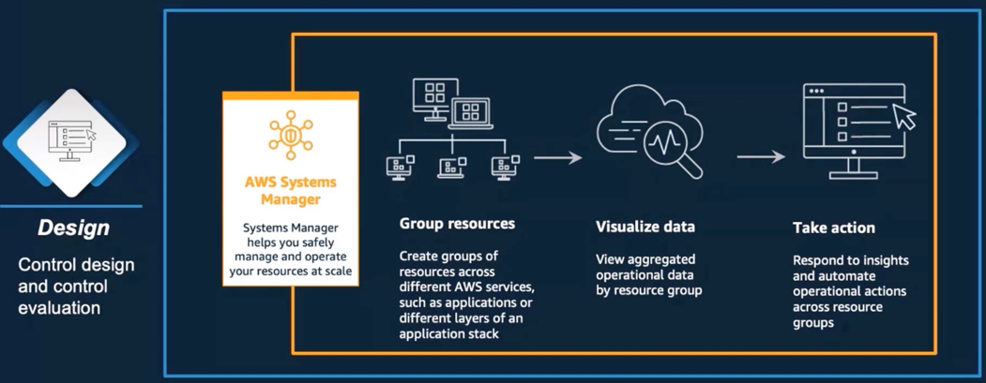
AWS Config Service
Helps with auditing and recording compliance of your AWS resources
Features
Recorder configuration (Auditing)
Compliance configuration
Price: https://aws.amazon.com/config/pricing
https://docs.aws.amazon.com/config/latest/developerguide/WhatIsConfig.html

Slide 3
AWS Config Service
Demo
Setting config for current region
Add rules
Test
Remediation Action
View Resource Timeline
Dashboard

Slide 4
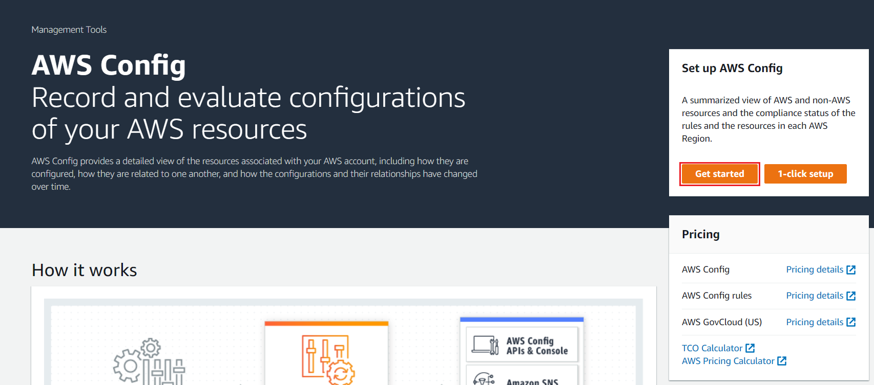
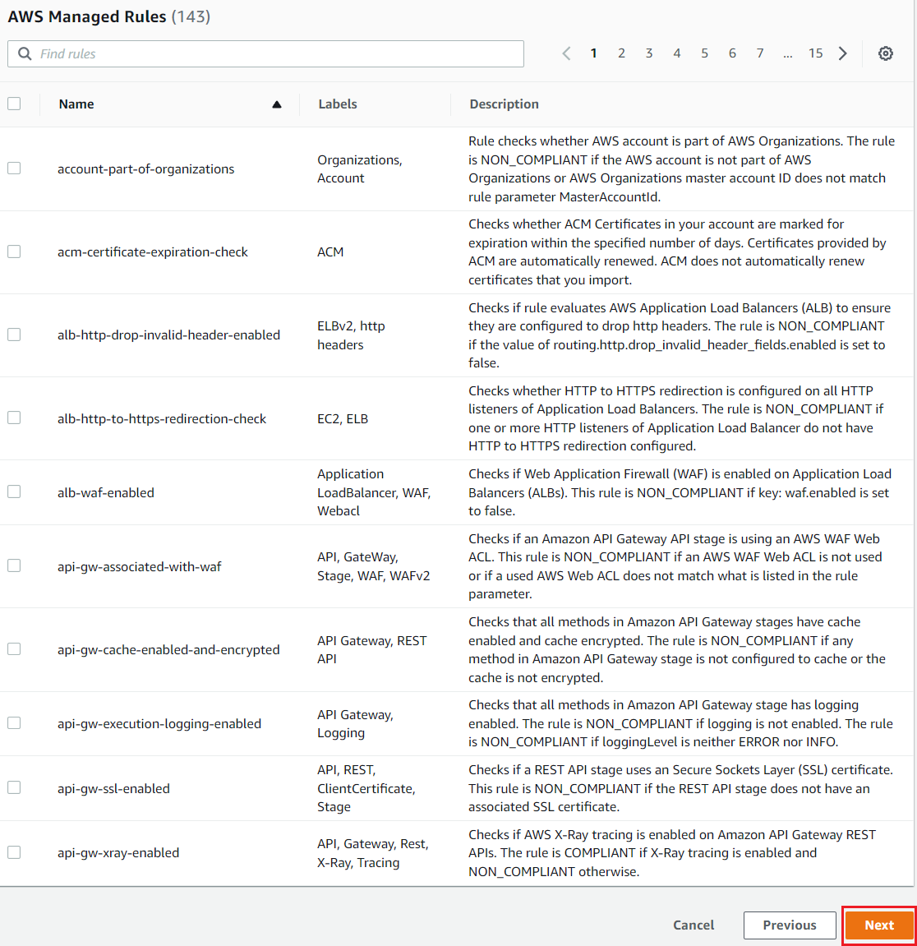
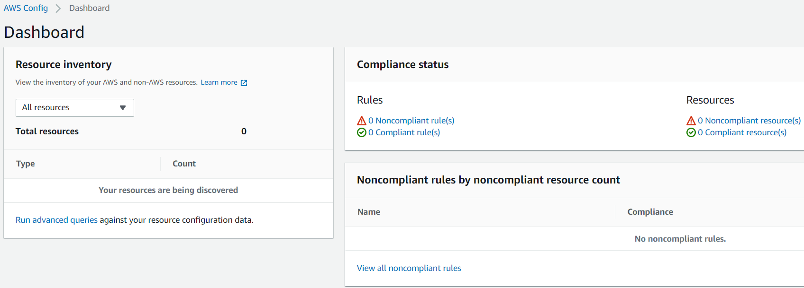
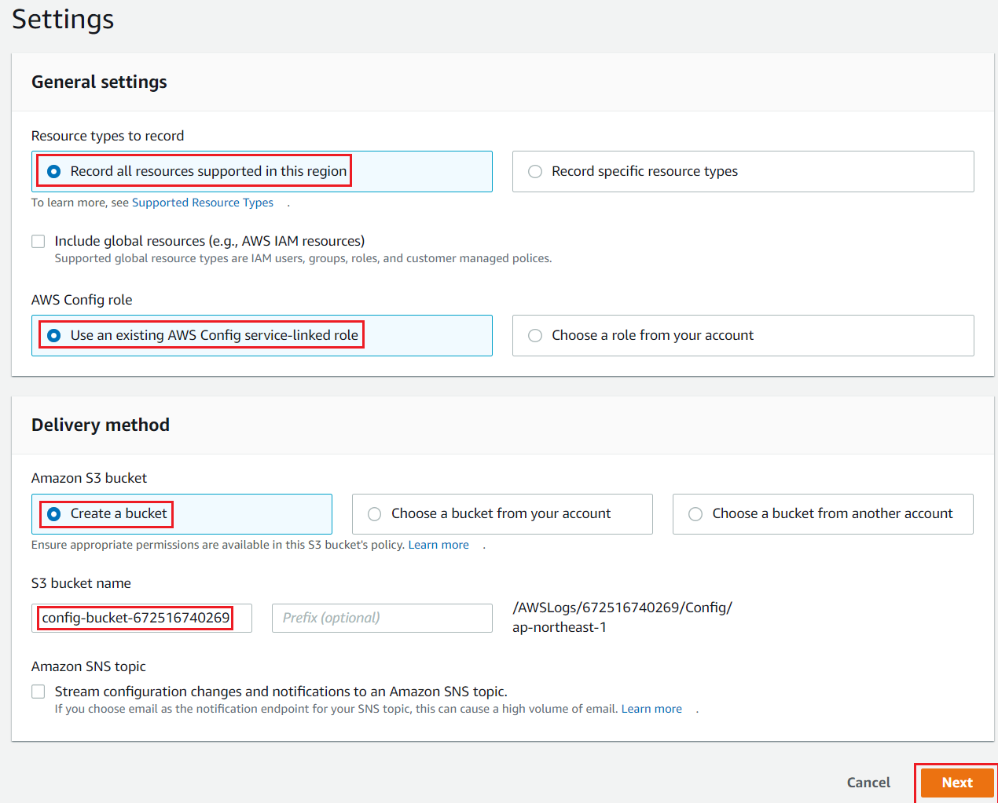
AWS Config Service
Setting config for current region
Dashboard
Skip rules
Settings

Slide 5
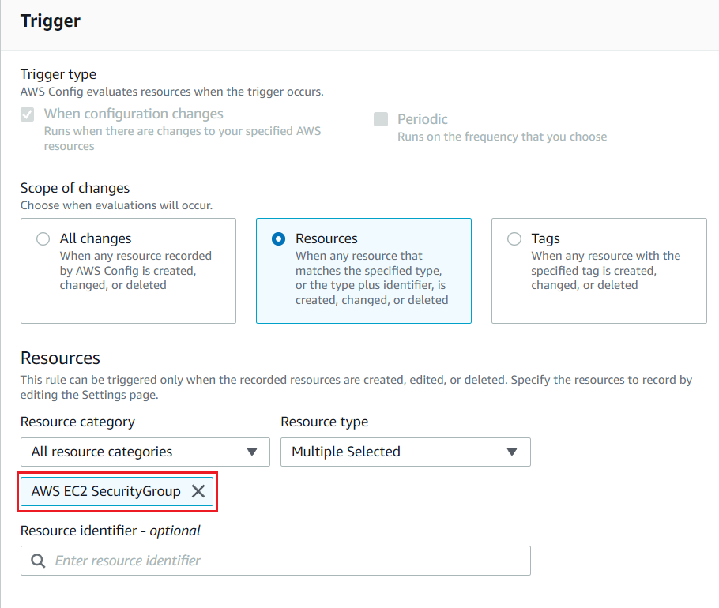
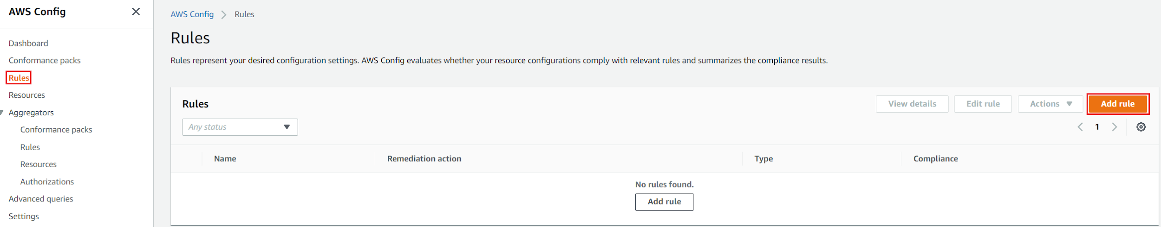
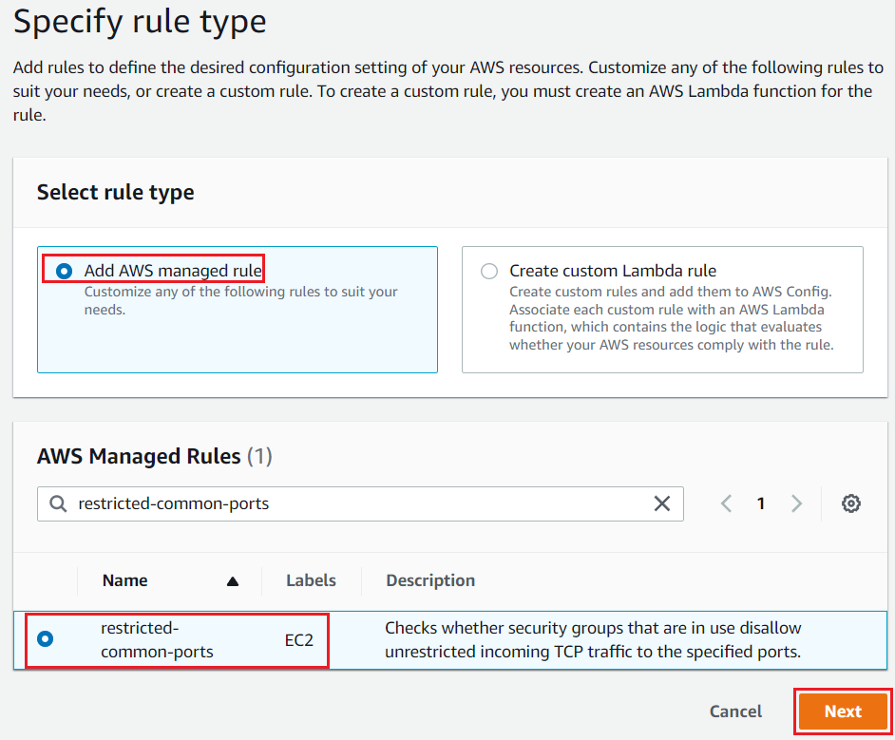
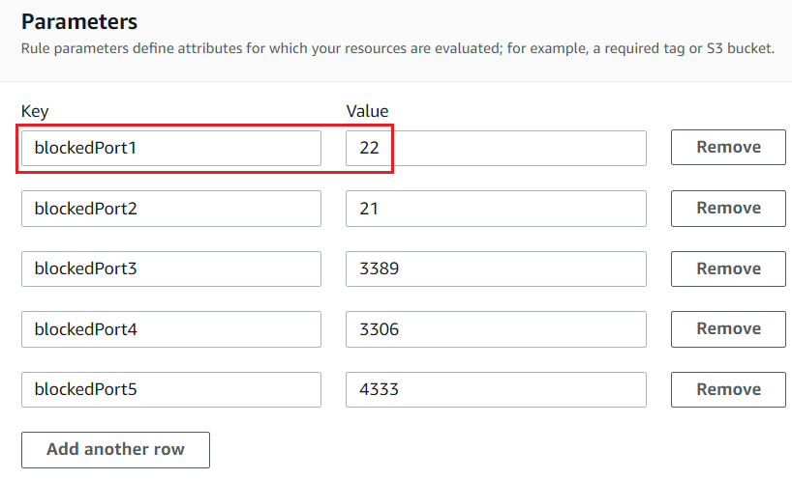
AWS Config Service
Add rules
Trigger to resource
Add rule template
Parameters

Slide 6
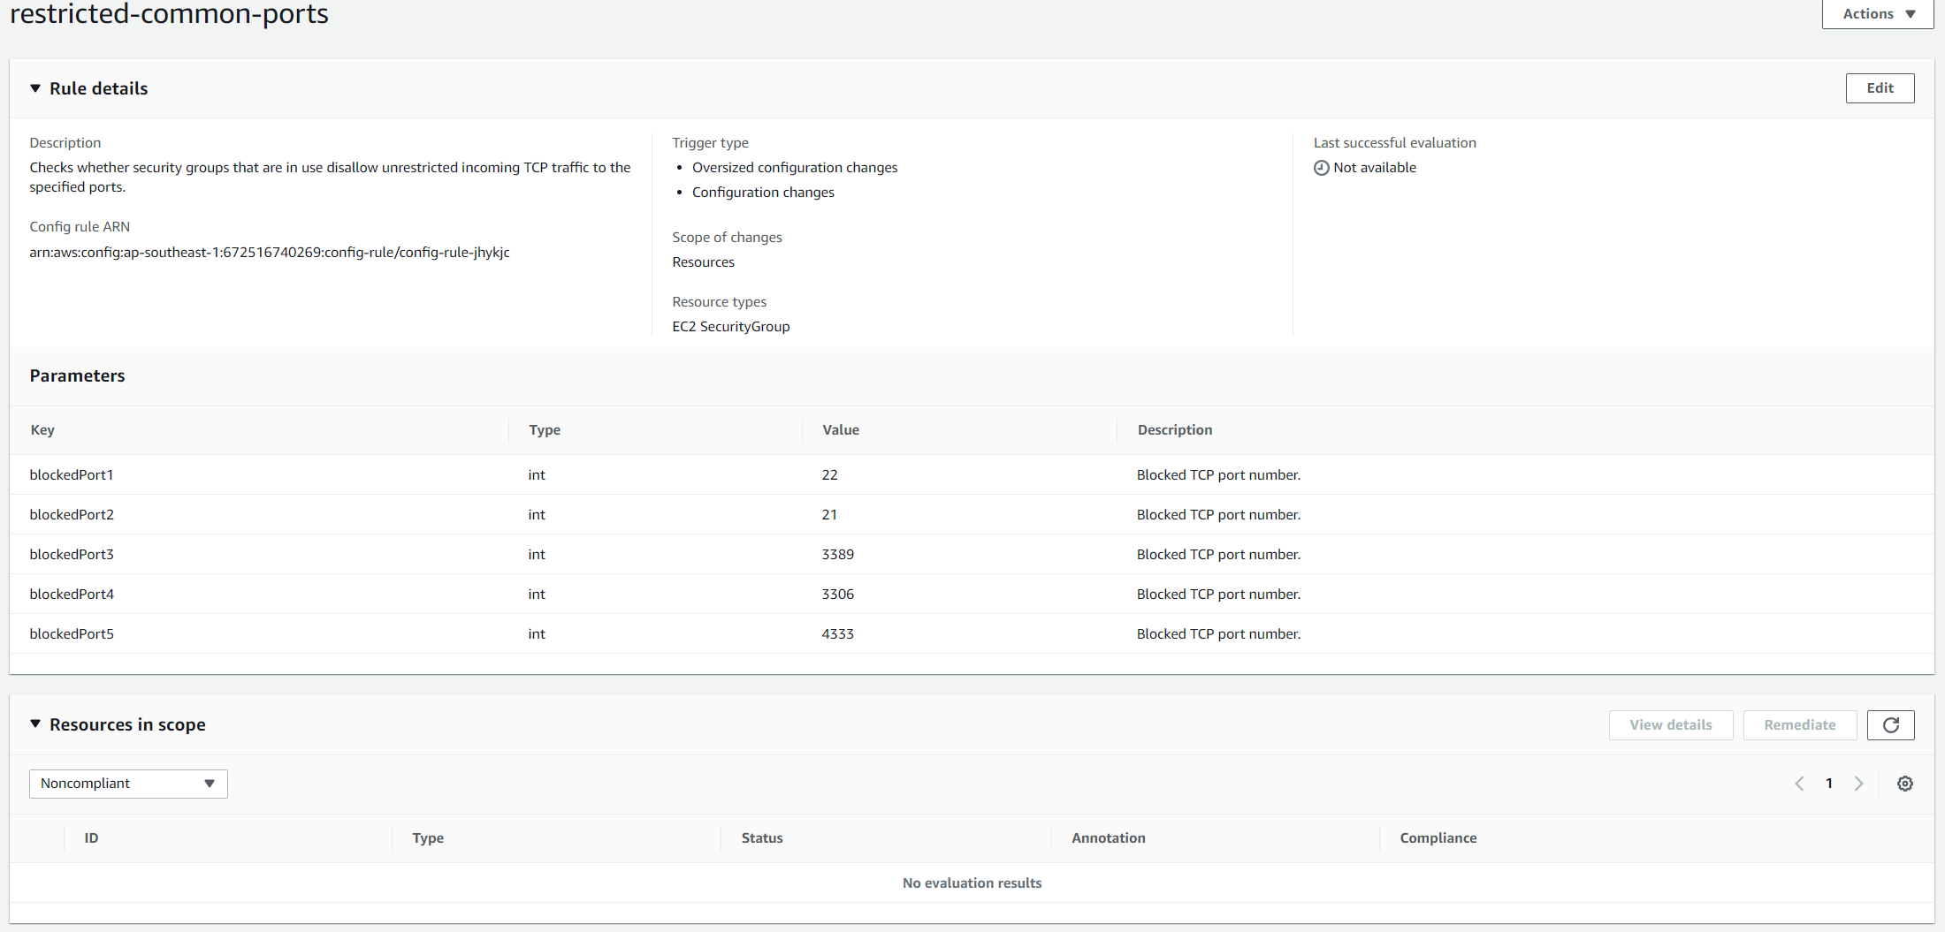
AWS Config Service
Detail information

Slide 7
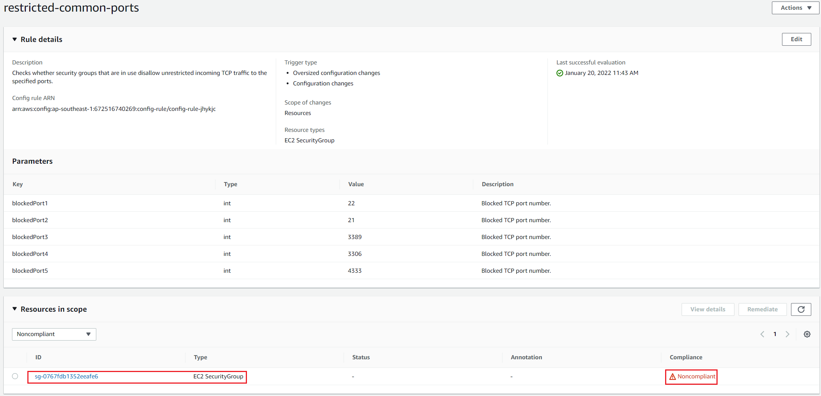
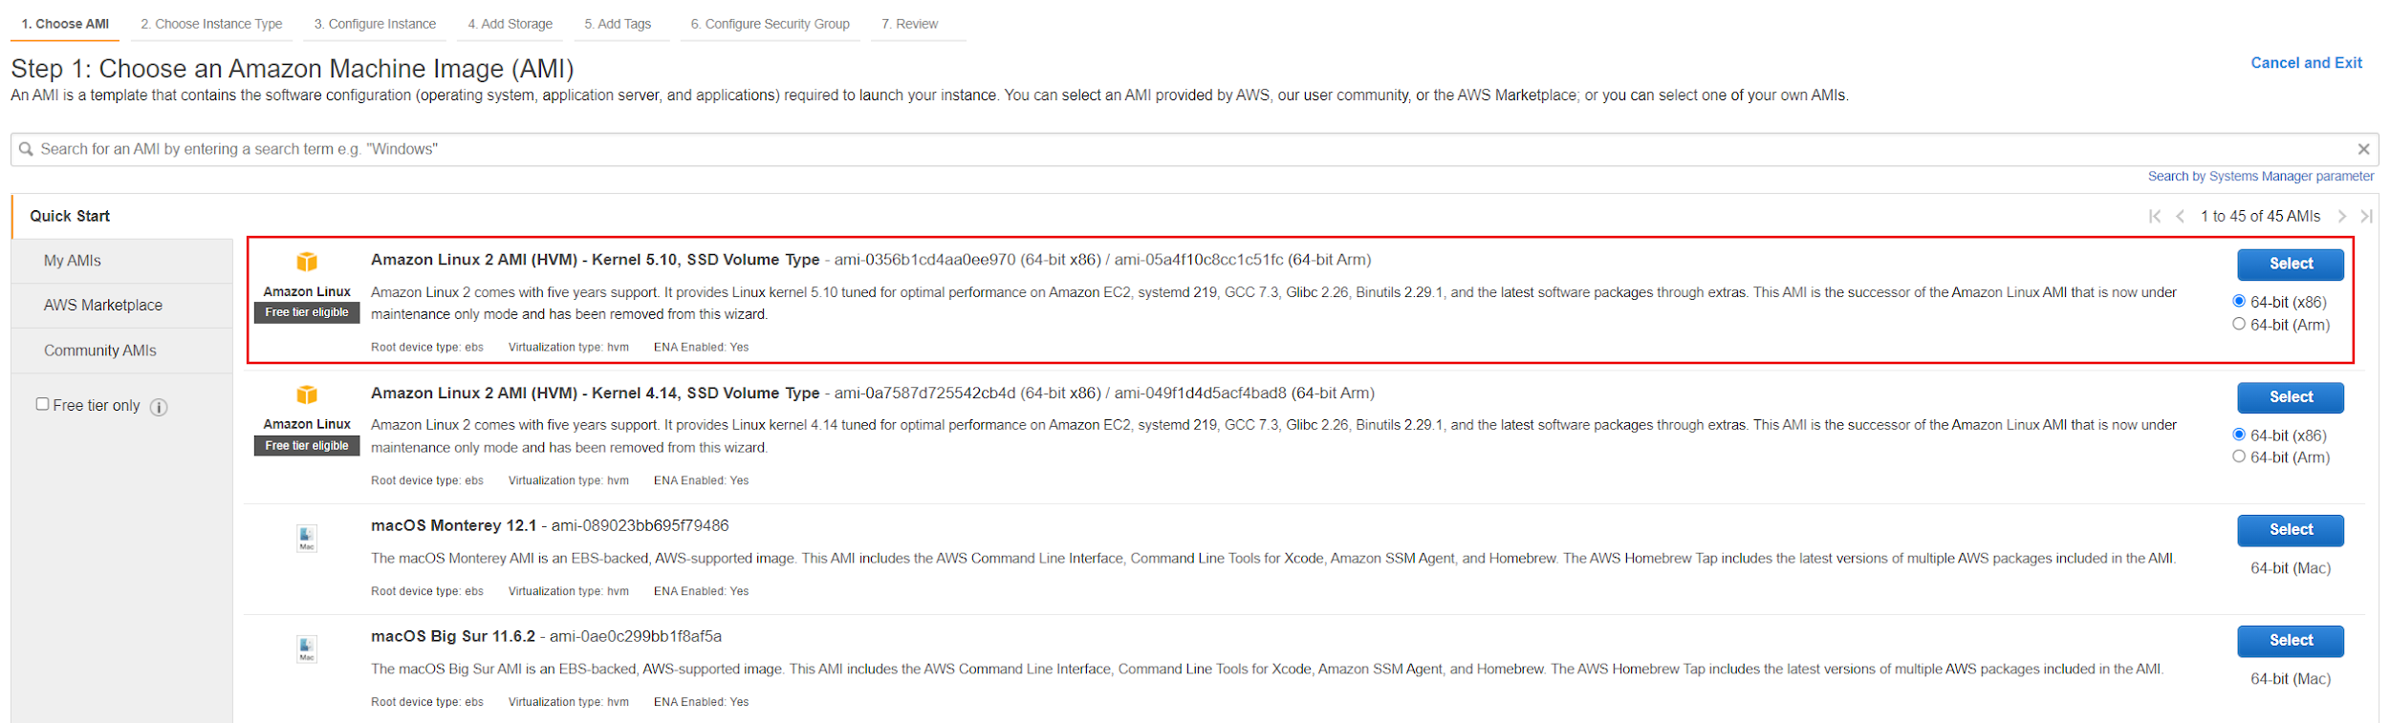
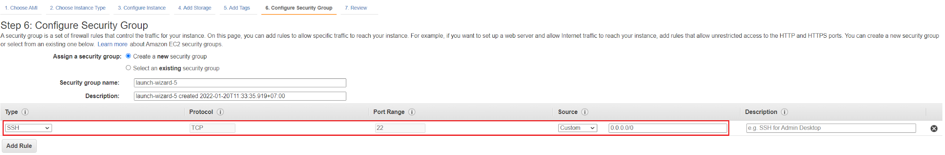
AWS Config Service
Test
Launch EC2
Noncompliant Rule
Security group with SSH from anywhere

Slide 8
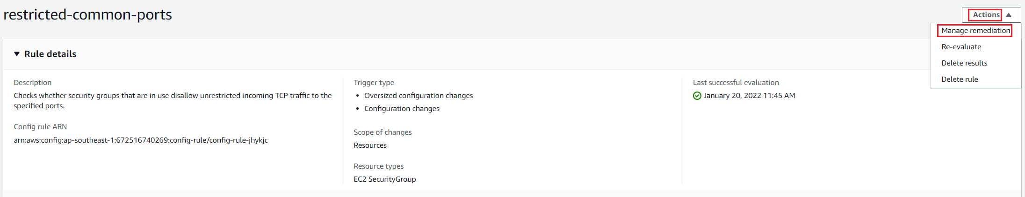
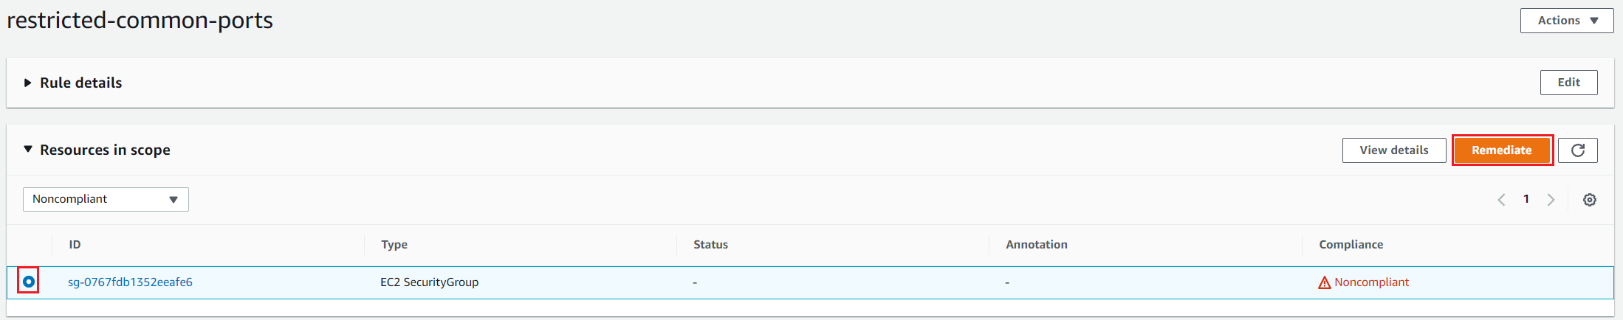
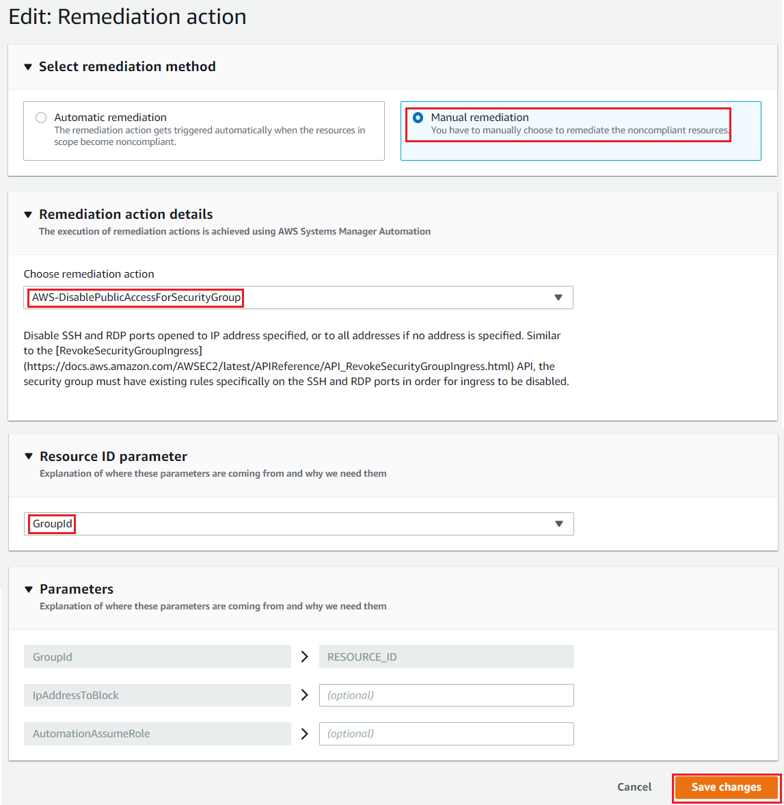
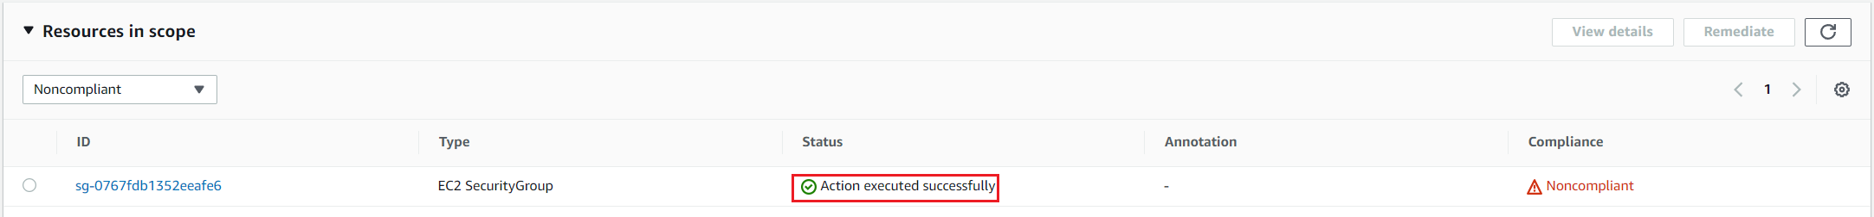
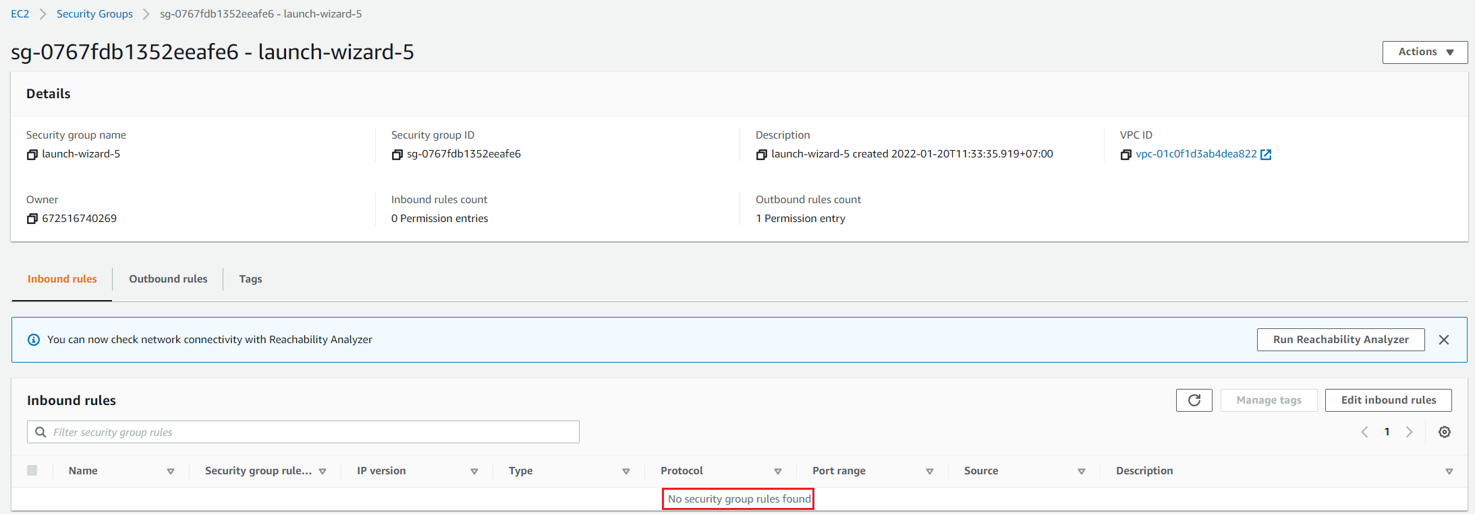
AWS Config Service
Remediation Action
Test
Create Remediation Action
Result

Slide 9
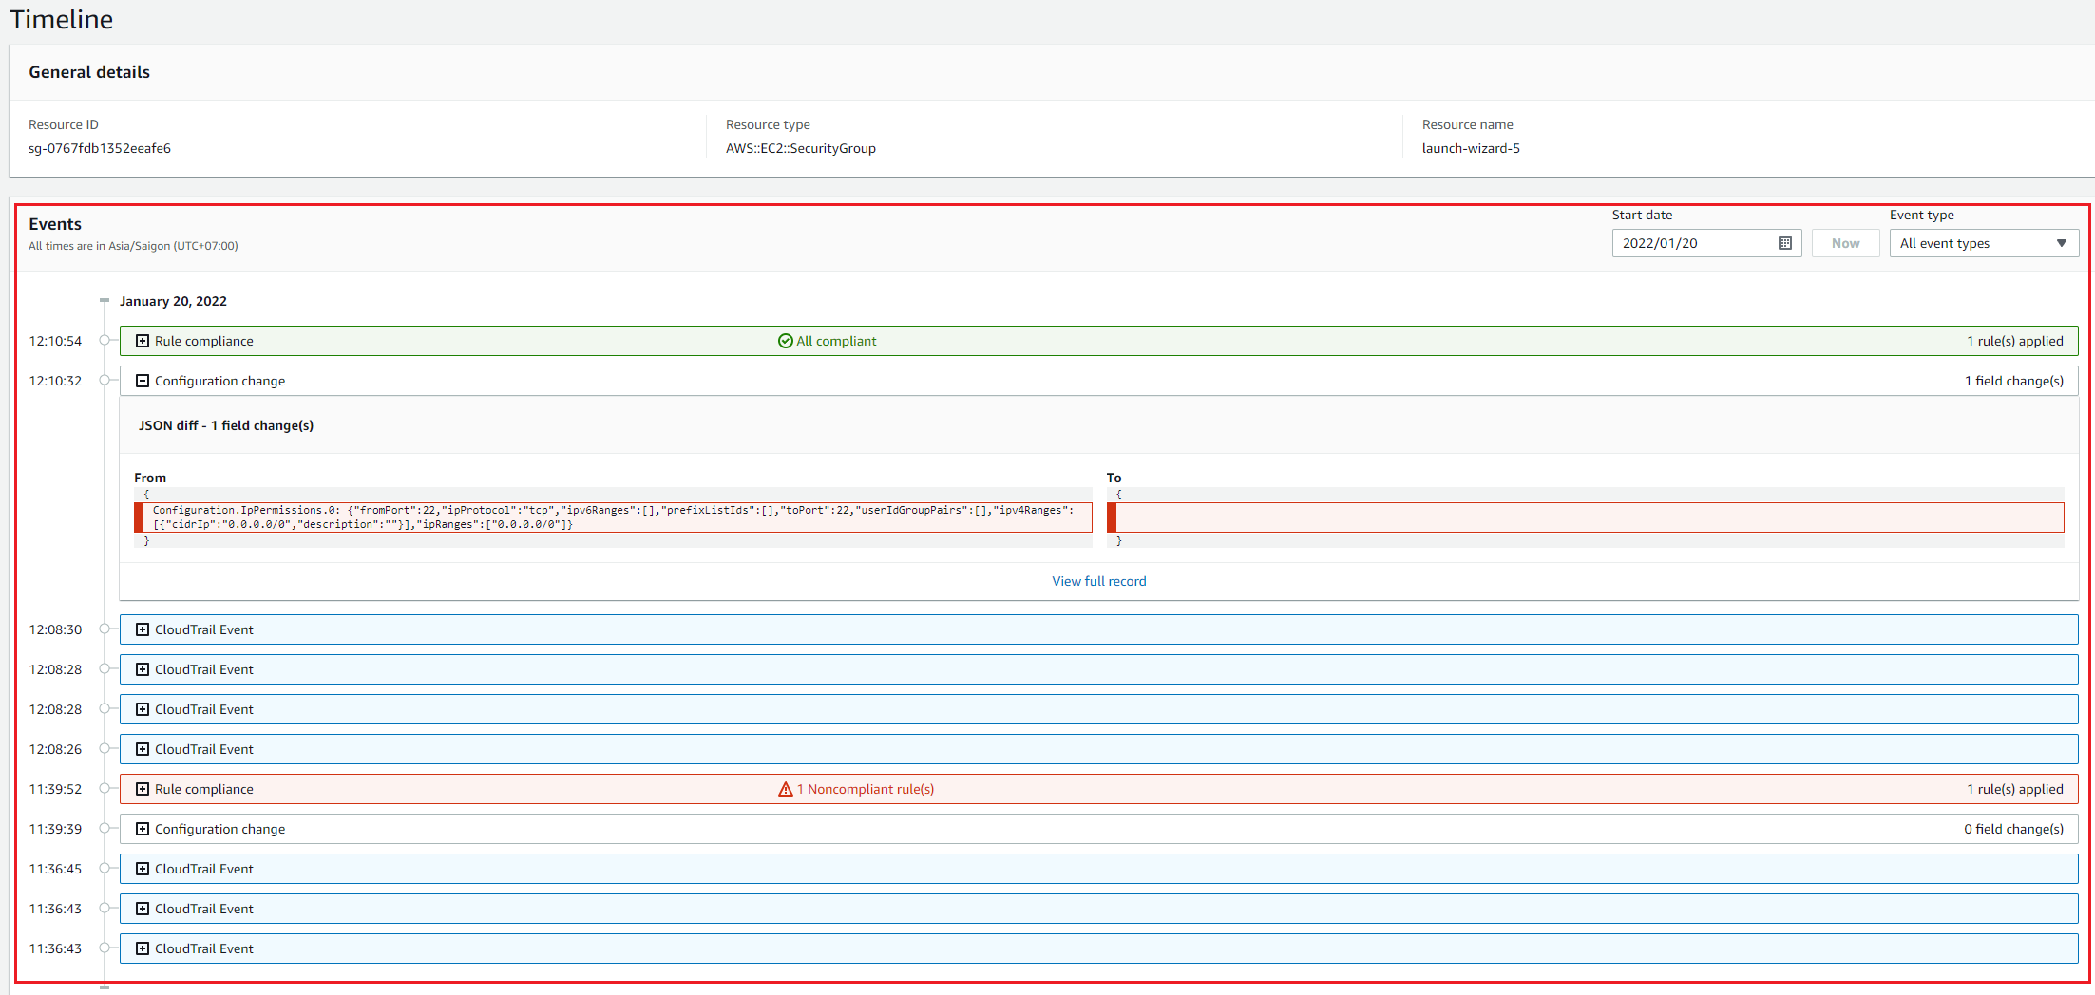
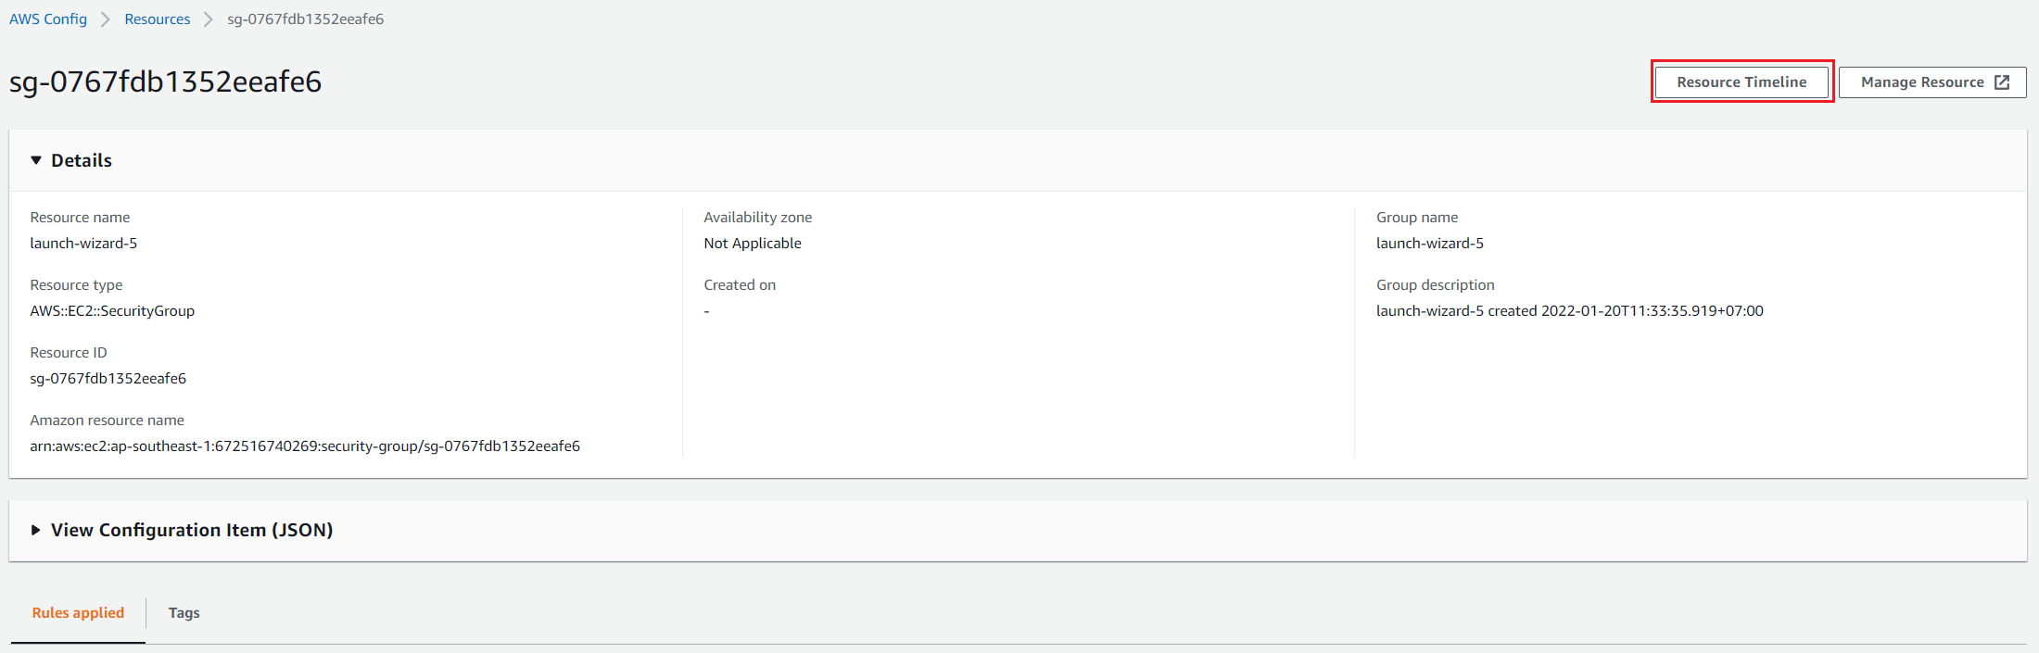
AWS Config Service
View Resource Timeline

Slide 10
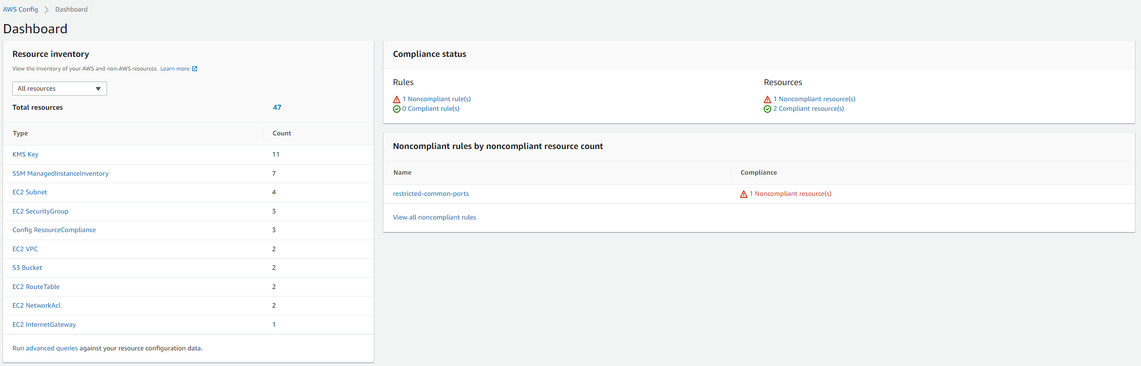
AWS Config Service
Dashboard

Slide 11
Assignment
Self-practice

Slide 12
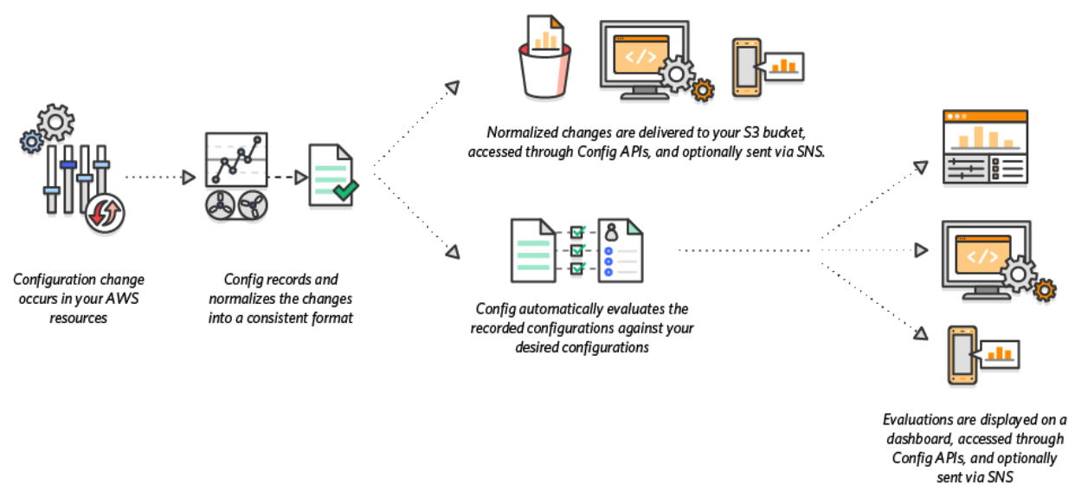
AWS Config Service
Flow

Slide 13
AWS Config Service
Components
Resource
Rule
Delivery method
Comformance packs
Advanced Query
Dashboard

Slide 14
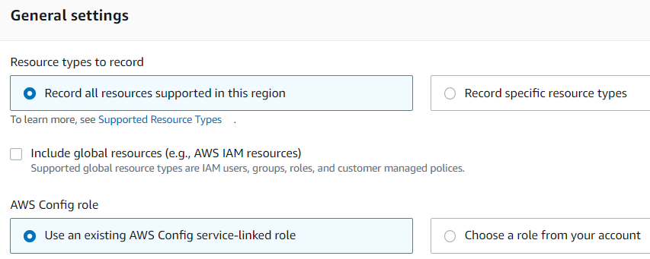
AWS Config Service
Resource
Support many AWS services
https://docs.aws.amazon.com/config/latest/developerguide/resource-config-reference.html
Support across accounts, multiple regions & multiple resources

Slide 15
AWS Config Service
Timeline
Check timeline configuration change

Slide 16
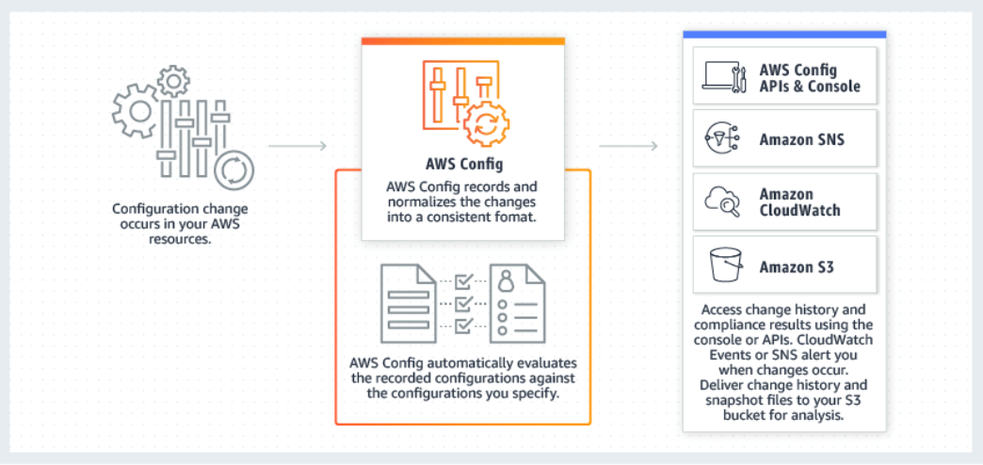
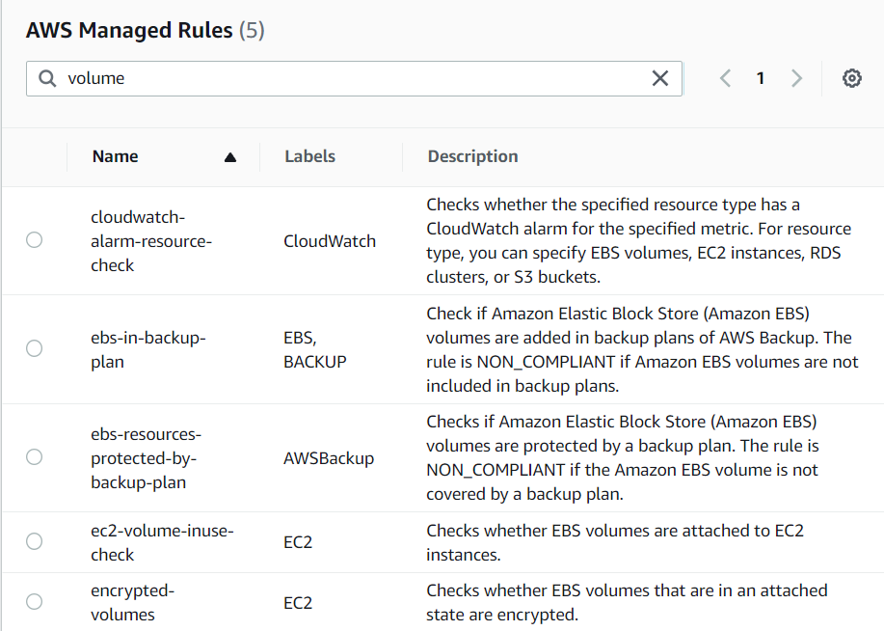
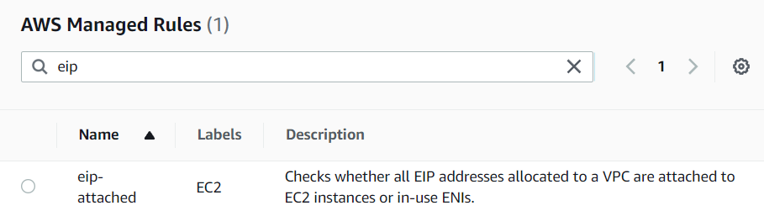
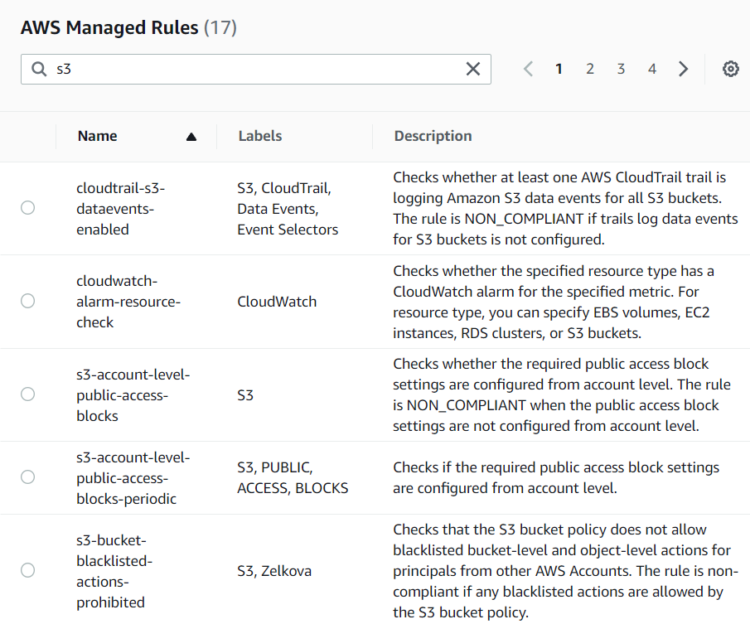
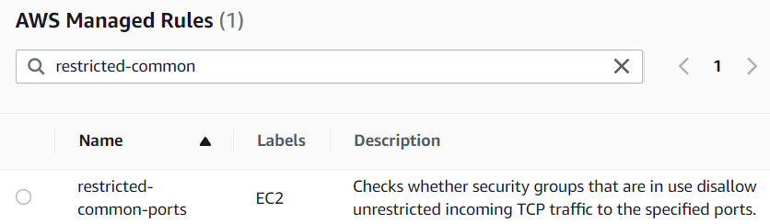
AWS Config Service
Rule
JSON format
Is Desired Configuration
Example:
EIP
Port EC2
Volume
S3

Slide 17
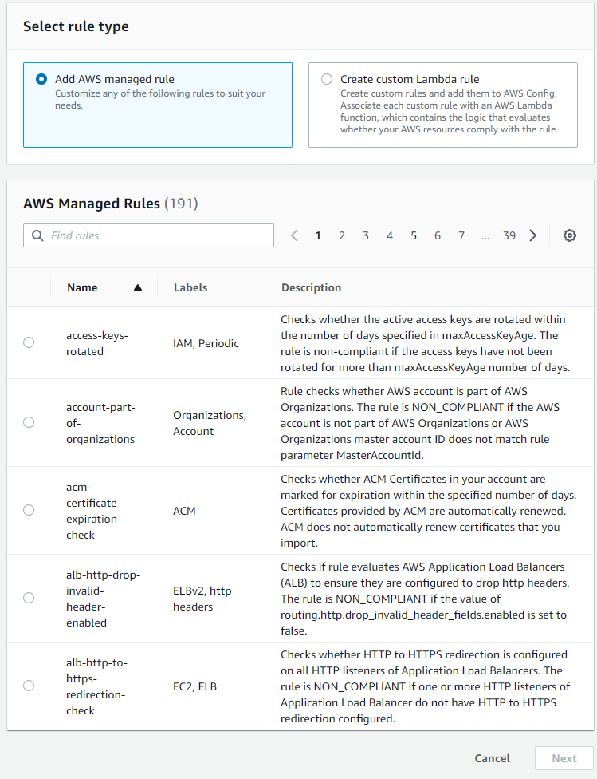
AWS Config Service
2 types
AWS Managed rules (over 75)
Custom rules (Using Lambda Function – next lesson)
Rule will be checked and evaluated when created & modified

Slide 18
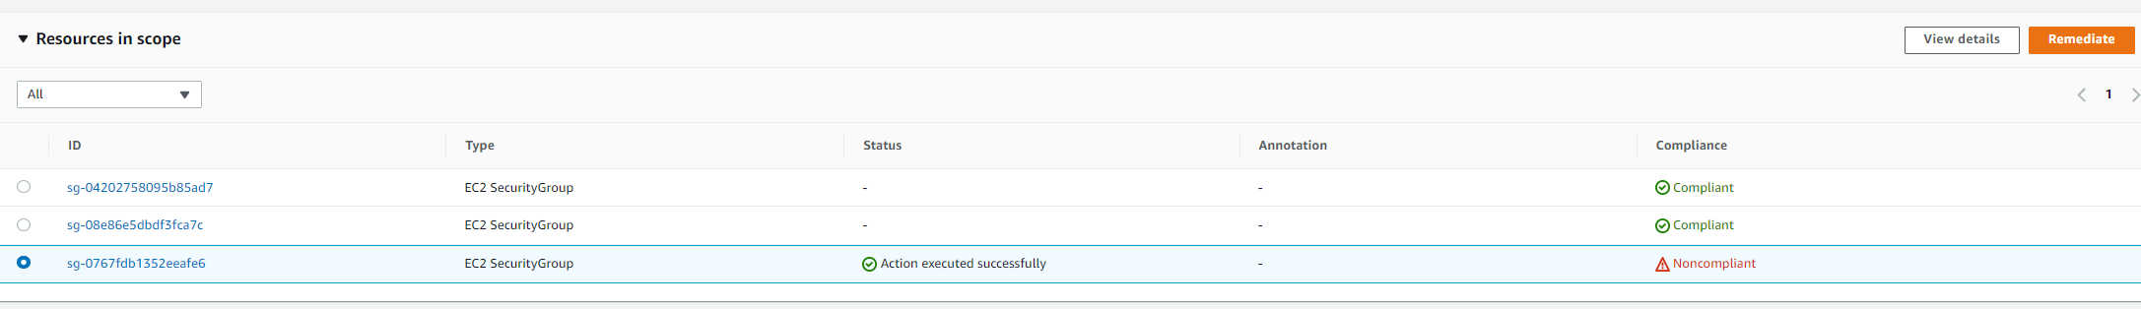
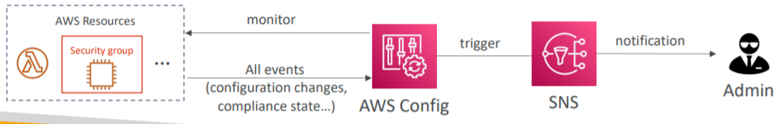
AWS Config Service
Status checking
Compliant
Non-compliant
Remediation Action
Config resource according to desired configuration or perform other actions (Ex: stop EC2, send email, …)
Automatic / manual

Slide 19
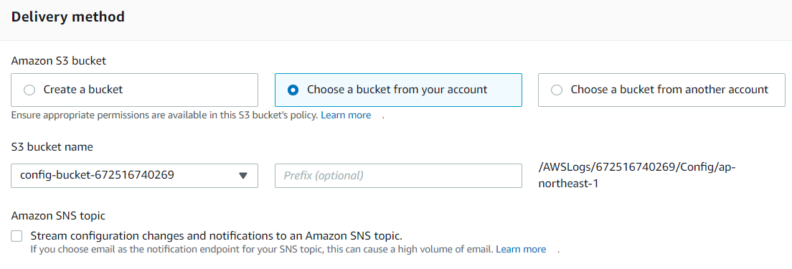
AWS Config Service
Delivery method
Store config history & config snapshot file on S3 Bucket

Slide 20
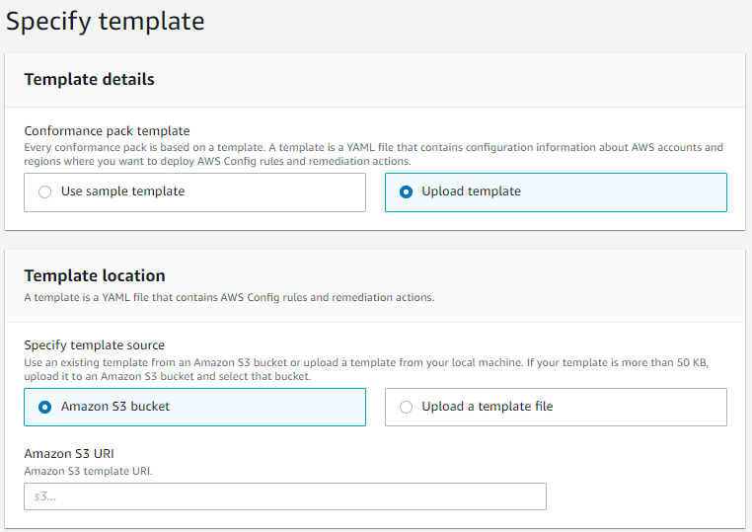
AWS Config Service
Comformance packs
yaml format
Deploy list rules & Remediation action

Slide 21
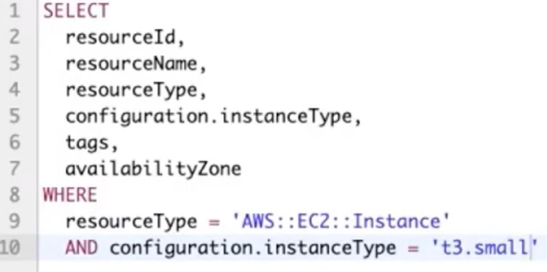
AWS Config Service
Advanced Query
Using SQL query to get resource informations

Slide 22
AWS Config Service
Dashboard

Slide 23
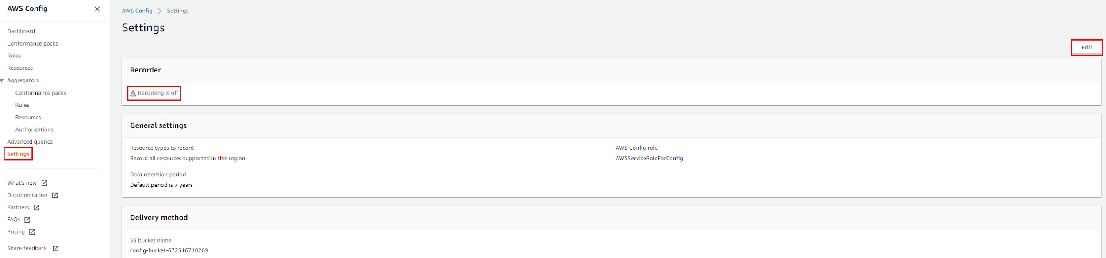
AWS Config Service
Turn off config

Slide 24
Assignment
Self-practice

Slide 25
Summary
CloudWatch Service
Performance monitoring (metrics - CPU, network, logs, …) & dashboards
Events & Alert
Log Aggregation & Analysis
CloudTrail Service
Record API calls made within your Account by everyone

Slide 26
Summary
AWS Config Service
Record configuration changes
Evaluate resources against compliance rules
Get timeline of changes and compliance

Slide 27
Assignment

Slide 28
Quiz

Slide 29
Reference
https://docs.aws.amazon.com/

Slide 30
Q & A
Copyright © VTI Academy All Rights Reserved

